Slide 1
JOYFUL MATHEMATICS
Pawan Kumar Ray
M.Sc(Maths), M.A ( EDU.) M.Ed, NET & SLET
Assistant Professor
Harkamaya College of Education Gangtok, Sikkim
COUNSELOR: CBSE, IGNOU, SBI ,NABARD etc.
Director: Competition coaching centre, Siliguri & Gangtok
President: Dr. Hedgewar Library Madhubani, Bihar .
Email:ccc4job@gmail.com
Contact No. 7908401075/ 9832359082
Blog:pawan4job.blogspot.com

Slide 2
Objective of class
L A L

Slide 3
ANSWER
LEARN
APPLY
LEAD

Slide 4
OBJECTIVE OF TEACHING MATHEMATICS
KASH

Slide 5
ANSWER
KNOWLEDGE
ATTITUDE
SKILLS
HAPPINESS

Slide 6
QUOTATION
the dream is not what we see in sleep
dream is which does not Let me sleep

Slide 7
QUOTATION
I hear and I forget.
I see and I believe.
I do and I understand.

Slide 8
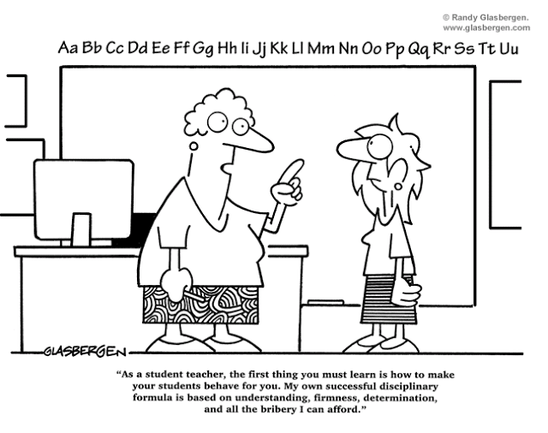
“As a teacher, the first thing you must learn is how to make your students behave for you. My own successful disciplinary formula is based on understanding, firmness, determination, and all the bribery I can afford.”

Slide 9
MAGIC :1
11 × 11= 121
111 × 111 = 12321
1111 × 1111 = 1234321
11111 × 11111 = 123454321
111111 × 111111 = 12345654321
1111111 × 1111111 = 1234567654321
11111111 × 11111111 = 123456787654321
111111111 × 111111111 = ?

Slide 10
MAGIC: 2
25 × 25 =625
35 × 35 = 1225
45 × 45 = 2025
55 × 55 = 3025
65 × 65 = 4225
75 × 75= 5625
85 × 85 = 7225
95 × 95 = ?

Slide 11
MAGIC: 3
9 × 9 =81
99 × 99 = 9801
999 × 999= 998001
9999 × 9999 = 99980001
99999 × 99999 = ?

Slide 12
M³
M³

Slide 13
MATHS
MAGIC
MASTI

Slide 14
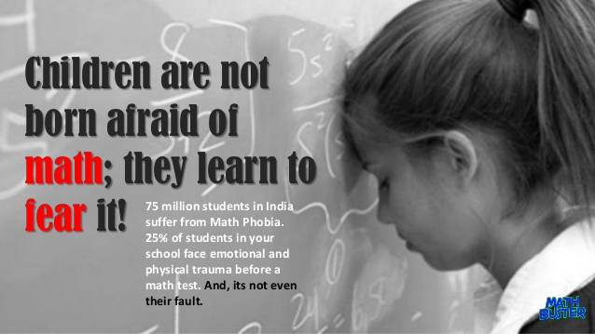

Slide 15
QUESTION
What is Challenging areas in learning of Mathematics?

Slide 16
ANSWER
Level of Intelligence
Lack of hard working Students
Background of Parents
Fear with subjects.

Slide 17
QUESTION NO. 2
Why students face problems?

Slide 18
ANSWER
No clear concept, understanding etc.

Slide 19
QUESTION
How learning of Mathematics can be made interesting and enjoyable for students?

Slide 20
ANSWER
Using different Skills, Techniques, Motivation etc.

Slide 21
:IDEAS:
SOME IDEAS THAT CAN CHANGE OUR LIFE

Slide 22
MY IDEAS
TATA

Slide 23
MEANS
THINK ALPHABETICALLY
&
TRICKS APPLY

Slide 24
Tricks for thinking alphabetically
Differentiate Ascending & Descending order
A comes 1st in alphabet i.e. Ascending order means smaller to bigger number. D comes after A in alphabet means D is bigger than A i.e. Descending means bigger to smaller number.
Another way; D for Descending & D for Decreasing that means In the case of Descending write Decreasing order means bigger to smaller.

Slide 25
Tricks for think alphabetically
Differentiate LESS THAN (<) & GREATER THAN SIGN (>)
Less than looking like L means less than Sign so other sign is Greater than
Differentiate acute angled triangle and obtuse angled triangle?
In acute word , A 1st letter is A. In obtuse word 1st letter is O. A is less than O and A means all, O means one. So, in acute angle all angles are less than 90⁰ .In obtuse angle one angle is more than 90⁰ but less than 180⁰

Slide 26
Tricks for Mathematical operation:
99+ 101 = ? ( 99 is one less than 100 and 101 is more than 1 so 100+100= 200) Ans. 200
1000 – 889 = ? ( 999- 888 = 111)
23 × 11 = ? ( 2, 2+3, 3 Ans. 253 We have to write unit no. 1st right side then add each other)
111 ÷ 5 = ? (111 × 2) ÷ ( 5 × 2) =222 ÷ 10= 22.2

Slide 27
FACTS
“ Make the students understand the Concept instead of teaching them the formula”

Slide 28
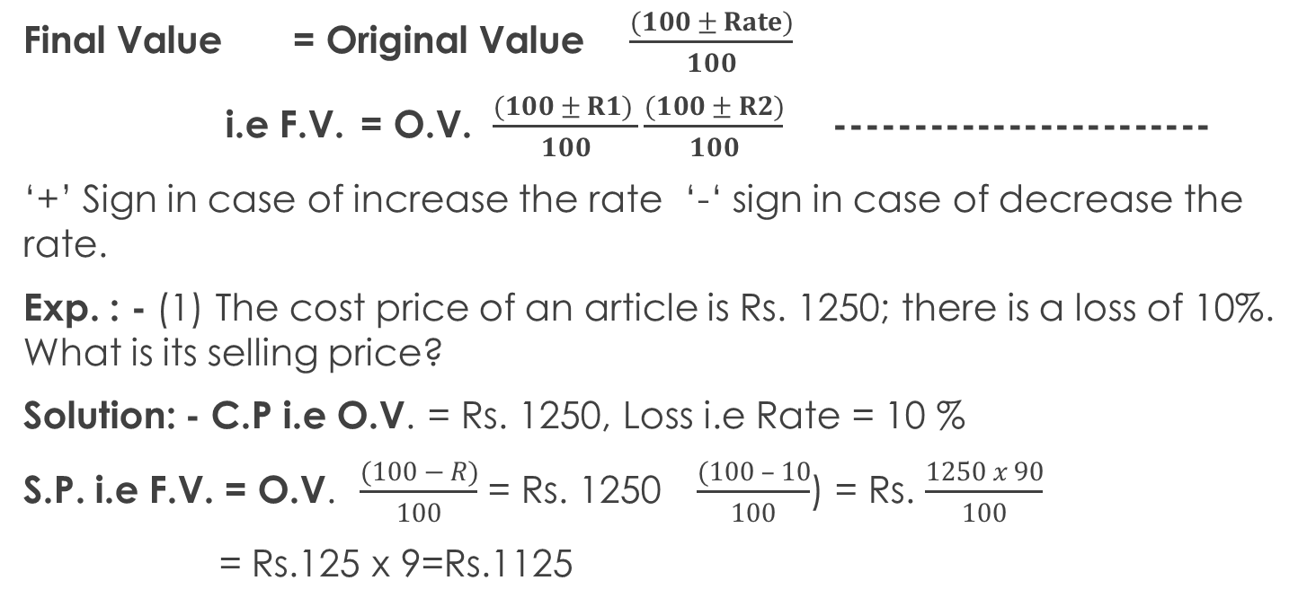
BRAHMASTRA CONCEPT
Final Value = Original Value $\frac{(100 ± Rate)}{100}$
i.e F.V. = O.V. $\frac{(100 ± R1) }{100}\frac{(100 ± R2)}{100}$ ------------------------
‘+’ Sign in case of increase the rate ‘-‘ sign in case of decrease the rate.
Exp. : - (1) The cost price of an article is Rs. 1250; there is a loss of 10%. What is its selling price?
Solution: - C.P i.e O.V. = Rs. 1250, Loss i.e Rate = 10 %
S.P. i.e F.V. = O.V. $\frac{(100 − R)}{100}$ = Rs. 1250 $\frac{(100 – 10}{100}$) = Rs. $\frac{1250 x 90}{100}$
= Rs.125 x 9=Rs.1125

Slide 29
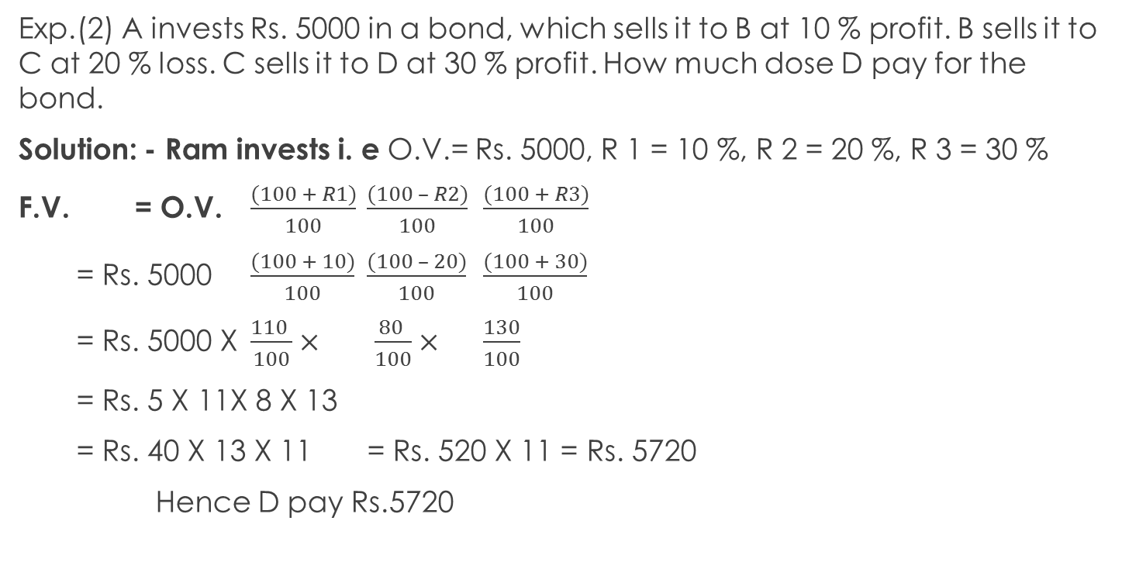
Exp.(2) A invests Rs. 5000 in a bond, which sells it to B at 10 % profit. B sells it to C at 20 % loss. C sells it to D at 30 % profit. How much dose D pay for the bond.
Solution: - Ram invests i. e O.V.= Rs. 5000, R 1 = 10 %, R 2 = 20 %, R 3 = 30 %
F.V. = O.V. $\frac{(100 + R1)}{100}$ $\frac{(100 – R2)}{100}$ $\frac{(100 + R3)}{100}$
= Rs. 5000 $\frac{(100 + 10)}{100}$ $\frac{(100 – 20)}{100}$ $\frac{(100 + 30)}{100}$
= Rs. 5000 X $\frac{110 }{100}×$ $\frac{80 }{100}×$ $\frac{130}{100}$
= Rs. 5 X 11X 8 X 13
= Rs. 40 X 13 X 11 = Rs. 520 X 11 = Rs. 5720
Hence D pay Rs.5720

Slide 30
Making Teaching of Mathematics Effective Role of Smart Teacher
Learning needs: Importance of Mathematics
Checking the Previous knowledge
Conceptual understanding
Be flexible
Playful and experiential learning
Teaching strategies, Methods and TLM.
Connecting Mathematics with day to day life
Observation
Quick Solution.
Feedback from students

Slide 31


Slide 32

Everything is possible if source is available
“ My Act is My Message”

